Slide 1
Evaluating the role of cumulative history in auditory perceptual bistability

Slide 2
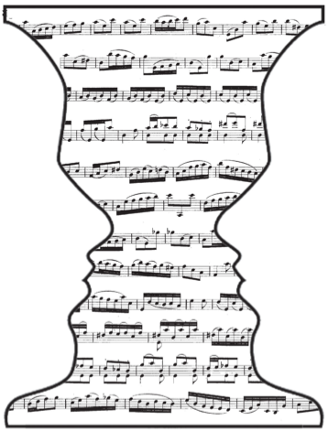
Topic review: The buildup of auditory stream segregation with alternations
Auditory scene analysis
Formation of auditory streams
Competition between perceptual organizations
Alternations for ambiguous stimuli
Pressnitzer, Suied, Shamma (2011)

Slide 3

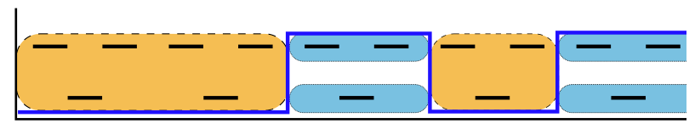
Experimental paradigm
++
time (s)
Daniel Pressnitzer, http://audition.ens.fr/sup/
van Noorden (1975)

Slide 4
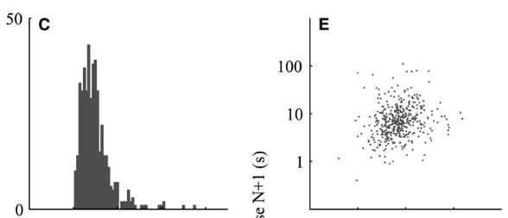
Percept to percept correlations
Percept duration
Percept N duration
++
Pressnitzer & Hupe, 2006

Slide 5
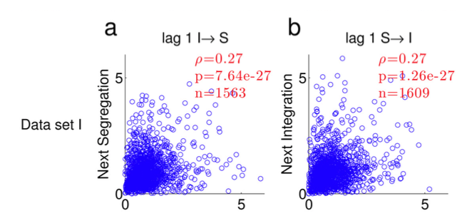
Percept to percept correlations
++
Barniv & Nelken, 2015

Slide 6
Introduction
Ambiguous auditory streaming stimulus
Small percept to percept correlations
What role does previous history play in dynamics of bistable perception? Does this elucidate neuronal mechanisms?
Statistical model
Neuronal simulations
Human subject data

Slide 7
Percept to percept correlations
++

Slide 8
Percept to percept correlations
++

Slide 9
Percept to percept correlations
++

Slide 10
Percept to percept correlations
++

Slide 11
++

Slide 12
MaxR revisited
Because we had limited samples for equidominant conditions for each subject, I wanted to adjust for sample size
The distribution of sample correlation coefficients is not quite normal.
Fisher transformed r is normally distributed with standard error 1/sqrt(n-3)
So I took fisher transformed r, divided by the standard error, to find how many standard errors each measurement was from zero (“Z score”)
I call a set of correlations “significant” if the pair of z scores has enough distance from the origin (sqrt(z1^2 + z2^2)>2.447)

Slide 13
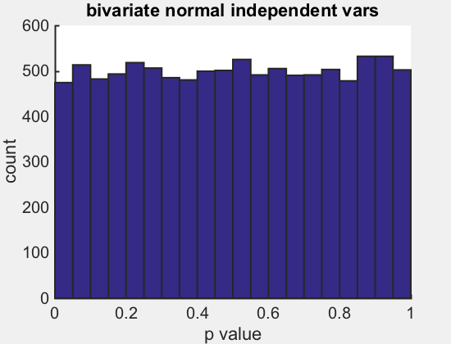
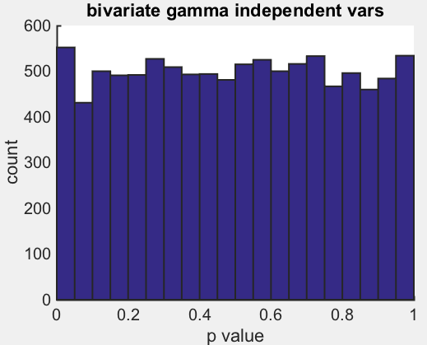
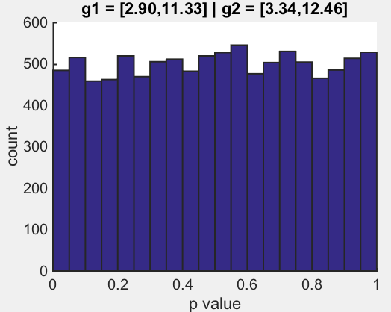
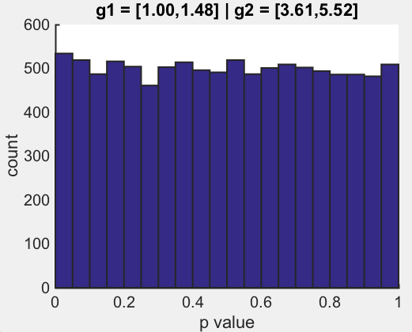
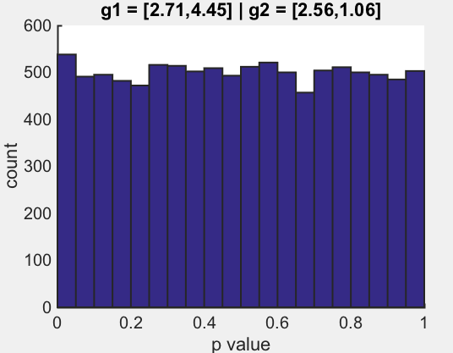
A brief description of combining correlation coefficients and determining p values
z_{r2}
++
z_{r1}

Slide 14
++

Slide 16
Cumulative history
?
state 2
state 1
?
?
state 2
state 1
time (s)
Does the duration of the next percept depend on previous history?
++

Slide 17
Introduction
Statistical model
History function H(t; τ)
T (duration) vs H
Estimating parameters
Neuronal simulations
Human subject data

Slide 18
History function

Slide 19
History function
τ

Slide 20
History function
τ

Slide 21
History function
τ

Slide 22
The next percept duration is drawn from a distribution that depends on H(t)
H(t)
p(T|H(t)) =

Slide 23
The next percept duration is described by a family of gamma distributions for which the mean varies with H(t)
H(t)
p(T|H(t_{j})) =

Slide 25
Durations vary with history

Slide 26
Durations vary with history

Slide 27
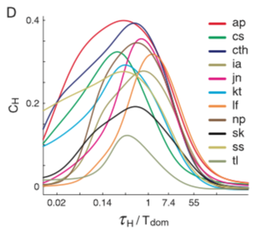
MaxR revisited
Pastukhov 2011 BR

Slide 28
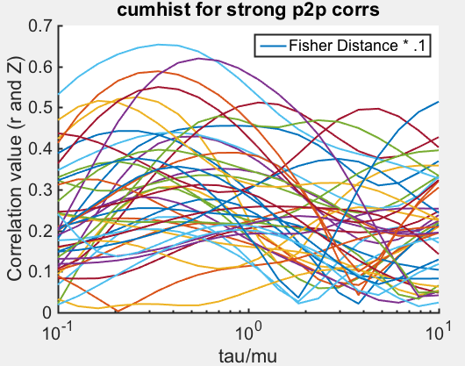

Slide 29
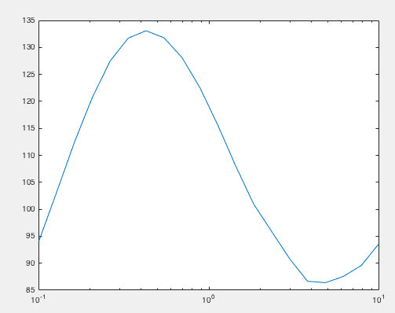

Slide 30
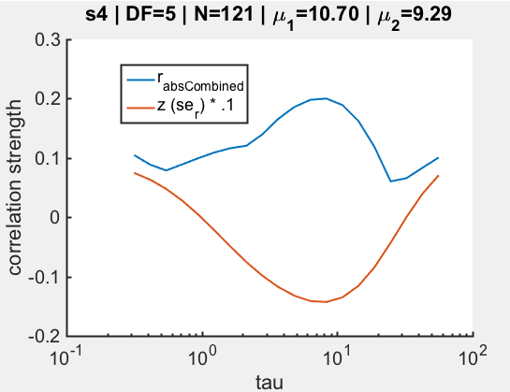
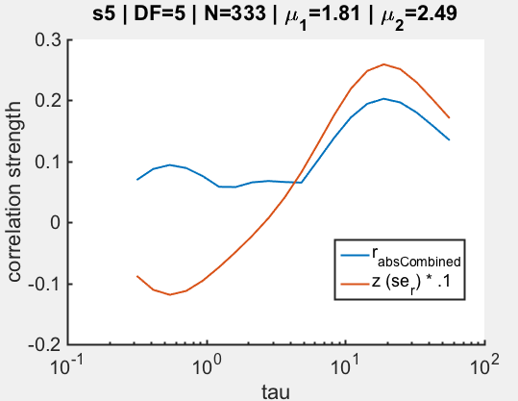
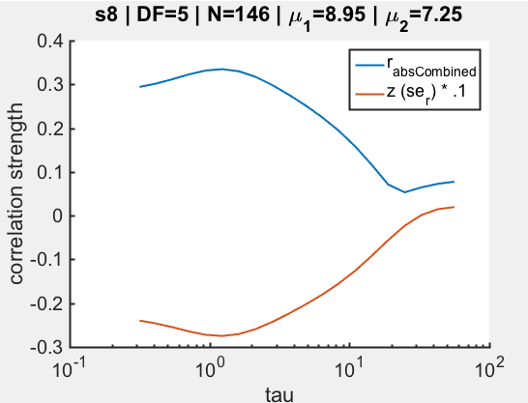
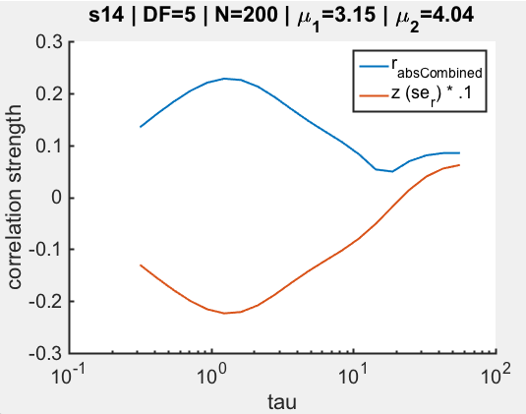
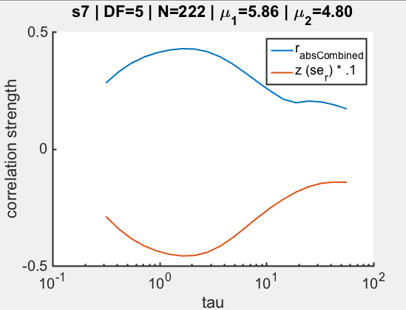
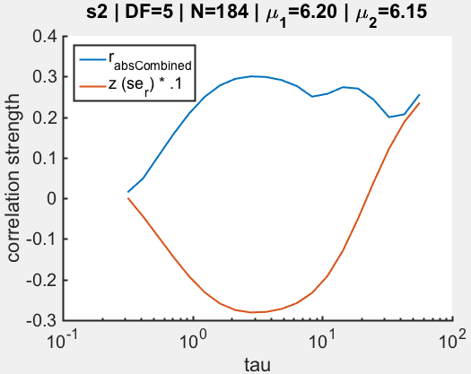
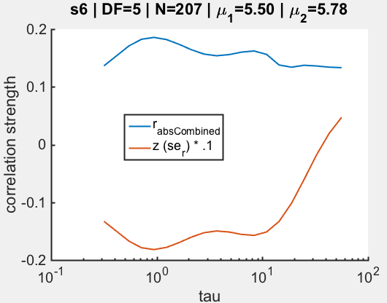
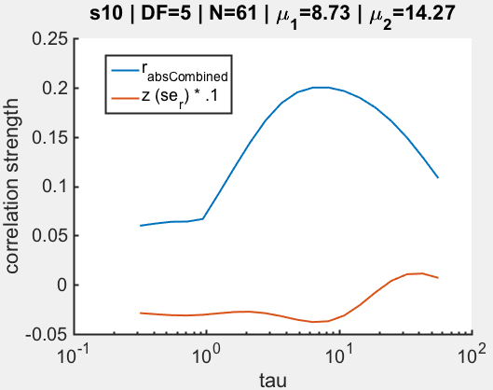
MaxR revisited
*
Sometimes we get a local max…
**
*
*
*

Slide 31
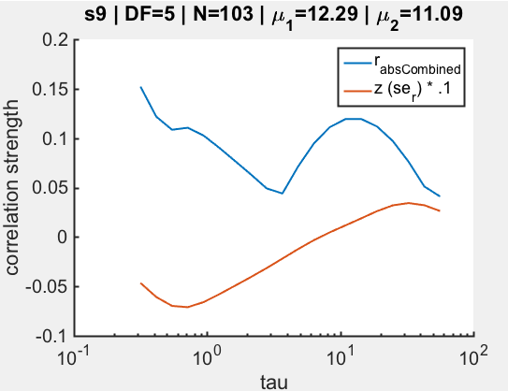
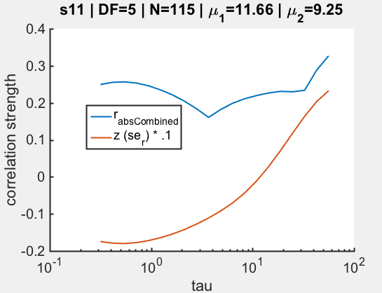
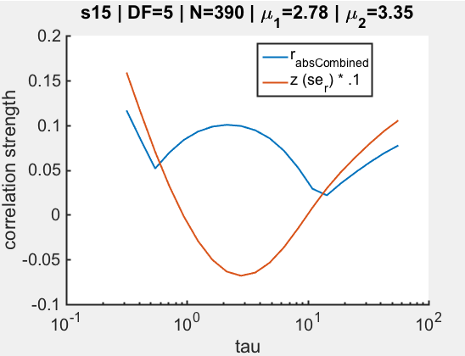
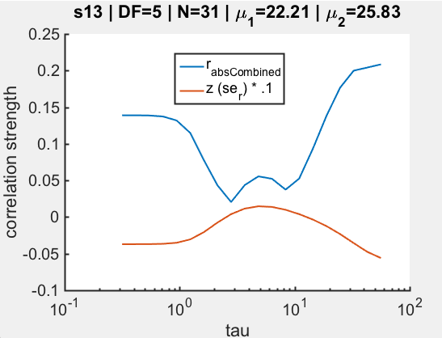
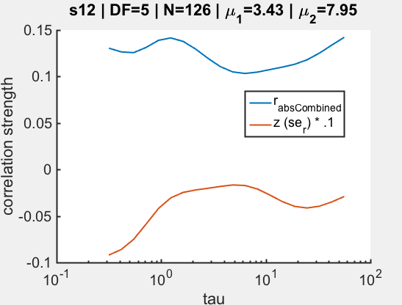
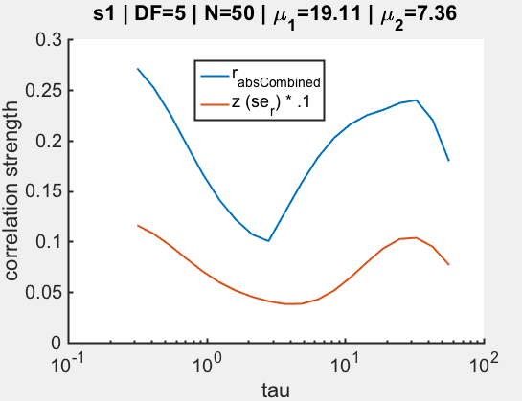
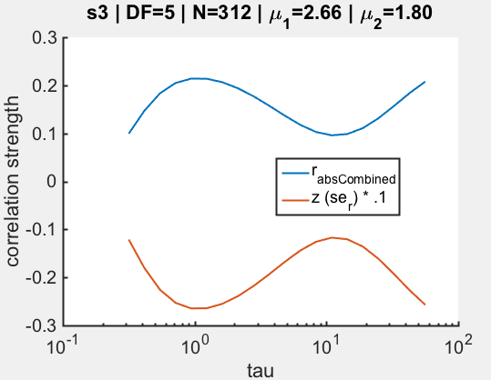
MaxR revisited
Sometimes significant corr’s aren’t bounded by tau, weird discontinuities
*
*
borderline?

Slide 32
Normalized equidominant?

Slide 33
Distribution means vary with H according to mx + B

Slide 34
Distribution means vary with H according to mx + B

Slide 35
Distribution means vary with H according to mx + B

Slide 36
Distributions vary with H according to LnT = mH + B

Slide 37
Cumulative history model parameters
k₁, k₂ – fixed shape parameter specifying gamma density joint distribution;
b₁, b₂ – log-mean at H_{x} = 0; “intercept”
m₁, m₂ – or alpha in p&B. Sensitivity to history; “slope”
τ - time scale of the history function
Data
History
Conditional Distribution
τ

Slide 38
Introduction
Statistical model
H(t; τ)
Duration drawn from one of a family of distributions for which mean is a function of H
Use MLE to find parameters
Neuronal simulations
Human subject data

Slide 39
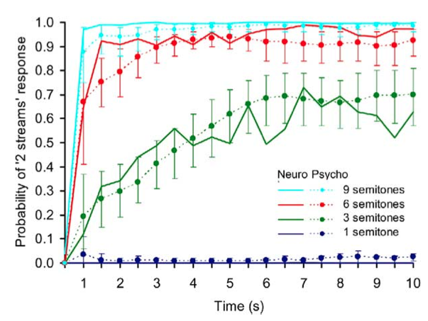
Buildup to stream segregation
++
Micheyl et. al. (2005)
human + monkey

Slide 40
Features of buildup
For long presentations, stimulus elicits perceptual alternations
First percept is (usually) always integration
(Weak) No first order correlations between subsequent percept durations
++

Slide 41
Alternating renewal process
++

Slide 42
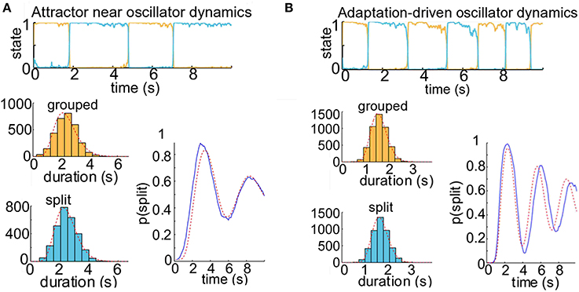
Alternative hypothesis: deviations observed with increasing adaptation
N>1000
++
r = .25
r = .3

Slide 43
Update: human data
15 participants, 3 blocks of 8 DF conditions, 4 minute trials
Stimuli – 125 msec tone durations, ABA_ with frequencies between 392 & 932 Hz
Minimum 30 – 120 sec between trials
Subjects performed 2AFC holding down one of 2 buttons to indicate percept
++
Rankin, Sussman & Rinzel, in review

Slide 44
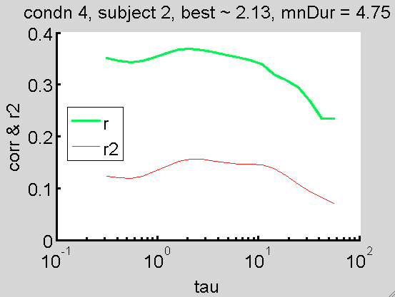
Analysis
++

Slide 45
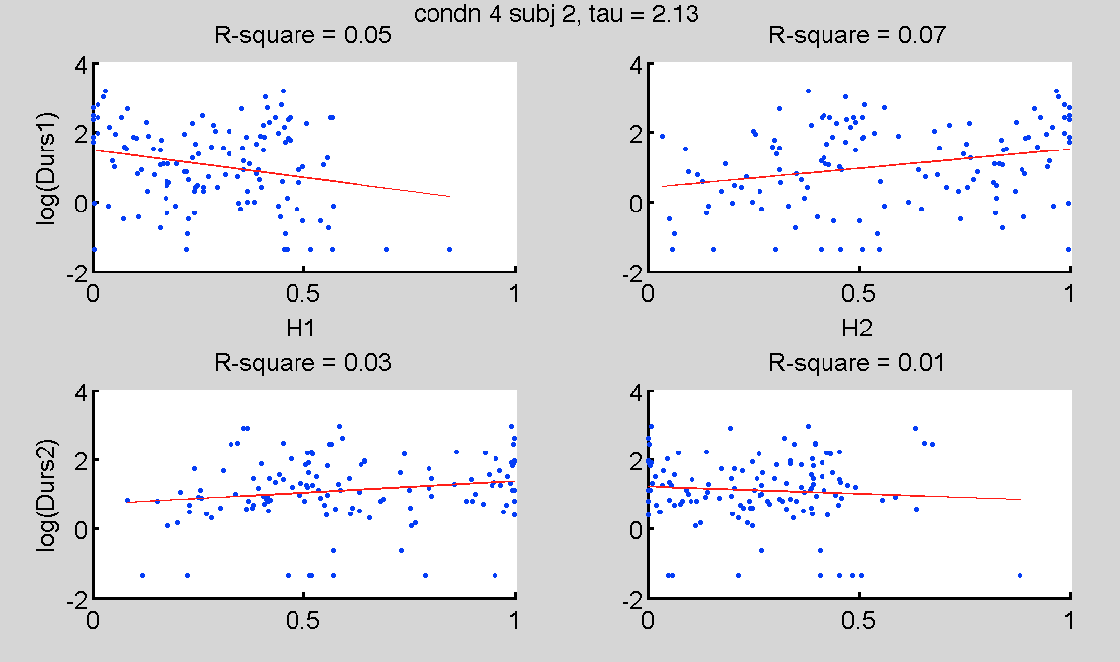
Analysis
++

Slide 46
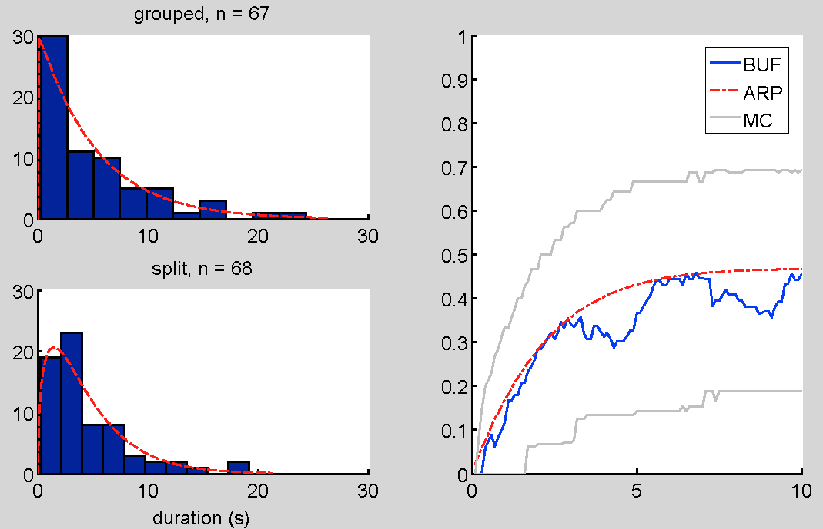
ARP provides good fit to psychophysical buildup functions
++

Slide 47
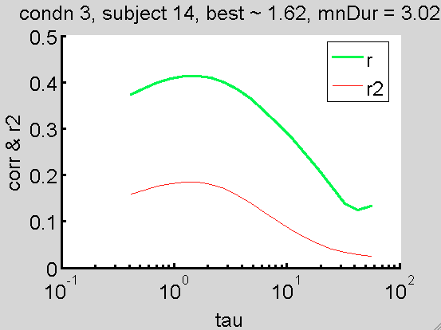
Analysis
++

Slide 48
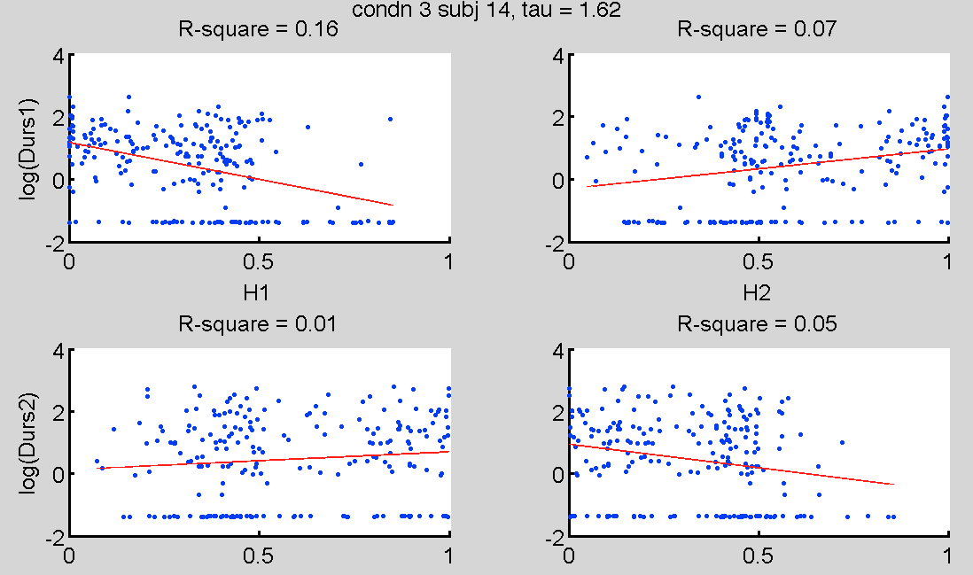
Analysis
++

Slide 49
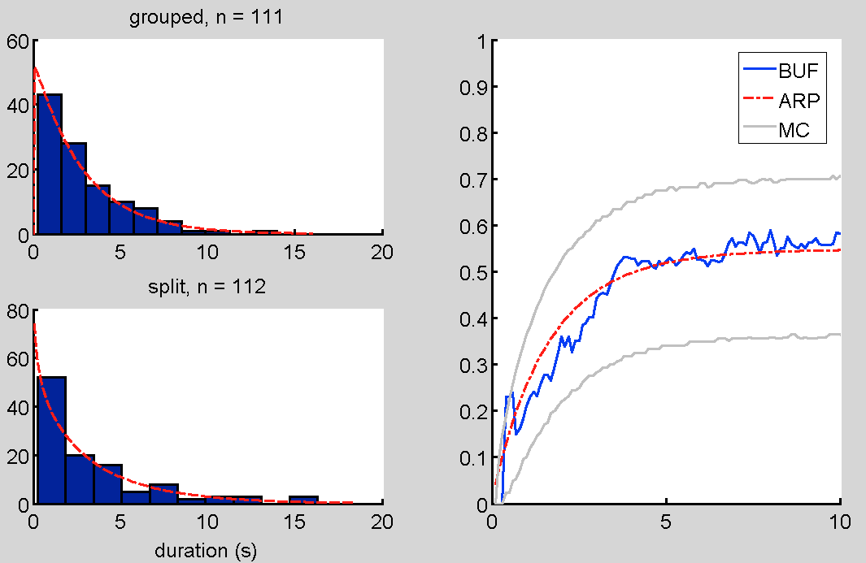
BUF
++

Slide 50
Further analysis
Use Monte Carlo simulations to generate data with significant history dependence and characterize deviations between BUF and ARP – how much data do we need?
Compute cumulative history measure in the data; novel application for ABA_ data
Combine data across subjects to get statistical power
++

Slide 51
Autoregressive generator
Ln(T) = a1 H1 + B + noise
++

Slide 52
Introduction
Statistical model
Neuronal simulations
How do neuronal parameters affect cumulative history?
What can cumulative history tell us about physiological processes?
Human subject data

Slide 53
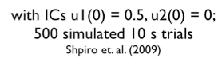
Competition model
Noisy input,
++

Slide 54
Competition models generate trial time courses
1299 samples
++

Slide 55
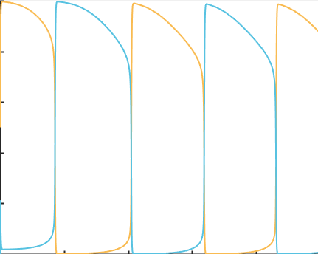

Slide 56
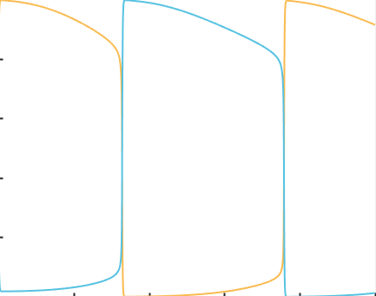

Slide 57
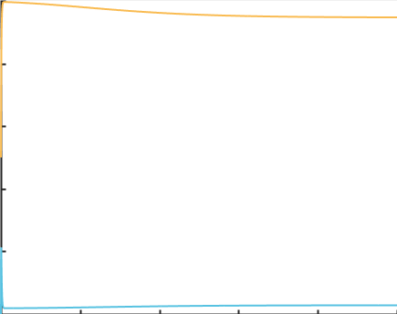

Slide 60
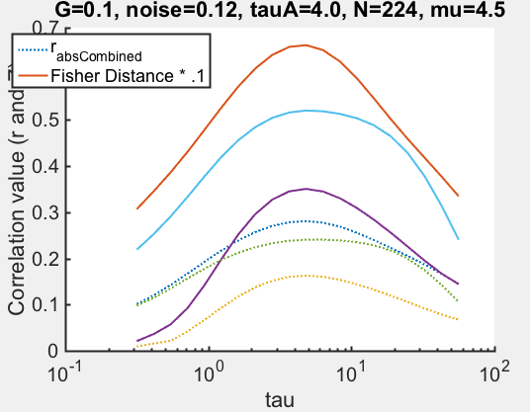

Slide 61
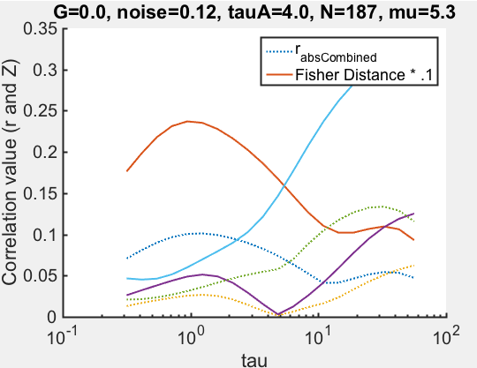

Slide 62
Fit model to simulated data with zero history dependence
K1 : 1.39
K2 : 1.34
B1 : 0.42
B2 : 0.60
M1 : 0.60
M2 : 0.05
Tau : 11.19
K1 : 1.38
K2 : 1.37
B1 : 0.69
B2 : 0.65
M1 : 0
M2 : 0
Tau : 1
(-4193 – (-4198)) = 2.495
Pval ~= .18
++

Slide 63
Oscillator: Ln(T) vs H
Parmhat:
k1 = 25.23
k2 = 31.57
b1 = .94
b2 = .95
m1 = -1.28
m2 = -1.27
Tau = 2.71
r = 0.35
fval (-LL) = 819

Slide 64
Competition Model- oscillator

Slide 65
Attractor (G=.3): ln(T) by H
Parmhat:
k1 = 5.64
k2 = 5.25
b1 = 1.06
b2 = 1.16
m1 = -.98
m2 = - 1.29
Tau = 2.24
fval (-LL) = 1169
Null:
k1 = 5.34
k2 = 4.83
b1 = .79
b2 = .80
m1 = 0
m2 = 0
Tau = “1”
fval (-LL) = 1202
2*(-1169-(-1202)) = 66 p~e-14

Slide 66
Attractor: histograms by H

Slide 67
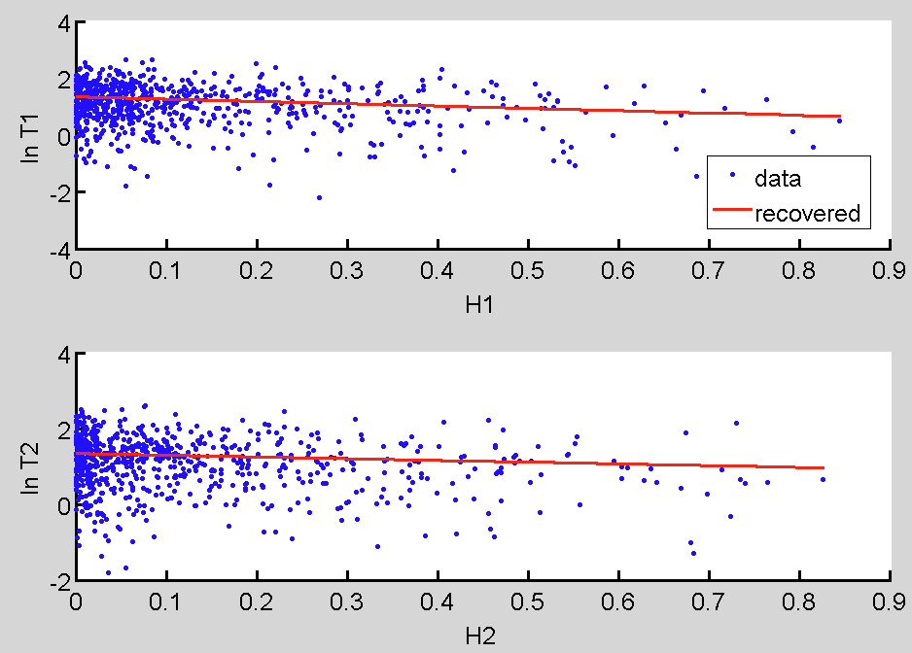
Attractor (G=.1): ln(T) by H
Parmhat:
k1 = 2.21
k2 = 2.49
b1 = 1.34
b2 = 1.34
m1 = -.81
m2 = - .45
Tau = 1.26
fval (-LL) =
2948
Null:
k1 = 2.24
k2 = 2.41
b1 = 1.27
b2 = 1.27
m1 = 0
m2 = 0
Tau = “1”
fval (-LL) = 2961
2*(-2961.4-(-2947.5)) = 66 p~1.9 e-6

Slide 68
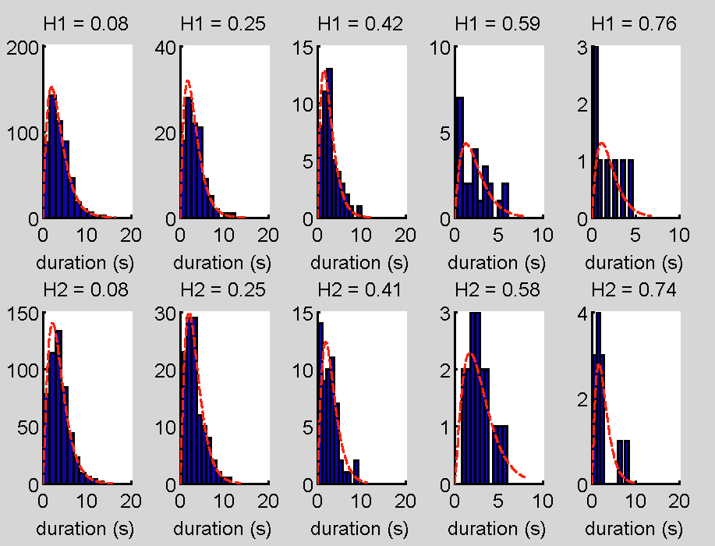
Attractor (G=.1): hists by H

Slide 69
Percept corrs:
rIS = .33
rSI = .32
Zr_combined = 13
Cumhist:
Tau_tau_opt ~ 1.6 sec
Zr = -10.5

Slide 70
I need to see where tau_opt falls relative to the mean durations
Percept corrs:
rIS = .38
rSI = .38
ZrCombined = 12
Cumhist:
Tau_opt ~ 2.8
ZrCombined ~ -14

Slide 71
rIS = .31
rSI = .45
ZrCombined = 8.8
Tau_opt ~ 8.3
zMax = -10.9

Slide 72
Human data- 8 subjs, 4 min trials x5

Slide 75
Fitted model gives similar statistics

Slide 76
But there’s not a lot of consistency in the key parameters, tau & m

Slide 77
But there’s not a lot of consistency in the key parameters, tau & m

Slide 78
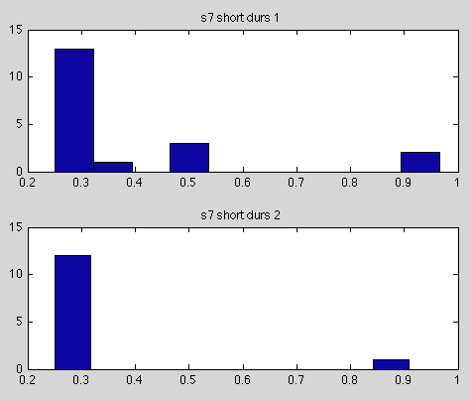
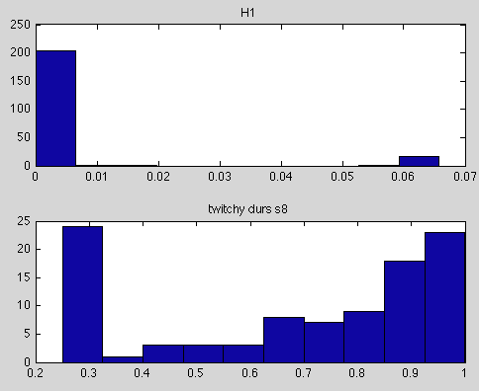
“twitchy” graphs

Slide 79
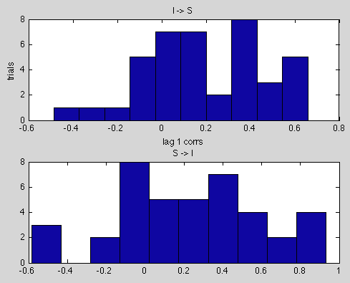
I-S and S-I corrs

Slide 80
To Do
Try normalization
Cross validation
Landscape analysis on pars

Slide 81
Acknowledgments
John Rinzel
Daniel Tranchina
Alex Reyes
Eero Simoncelli
Elyse Sussman
Amala Ankolekar-Hinge
Vik Keenan
Jason Mikiel-hunter
Josh Goldwyn
John D. Murray
Antje Ihlefeld
4th years

Slide 82
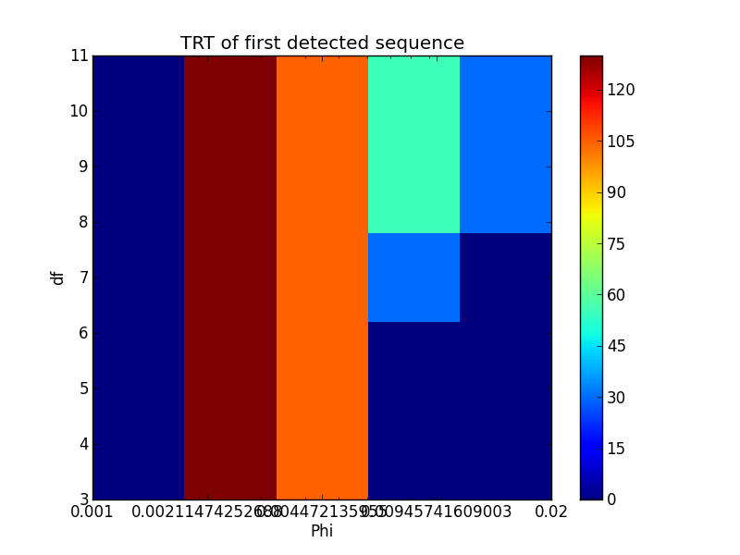
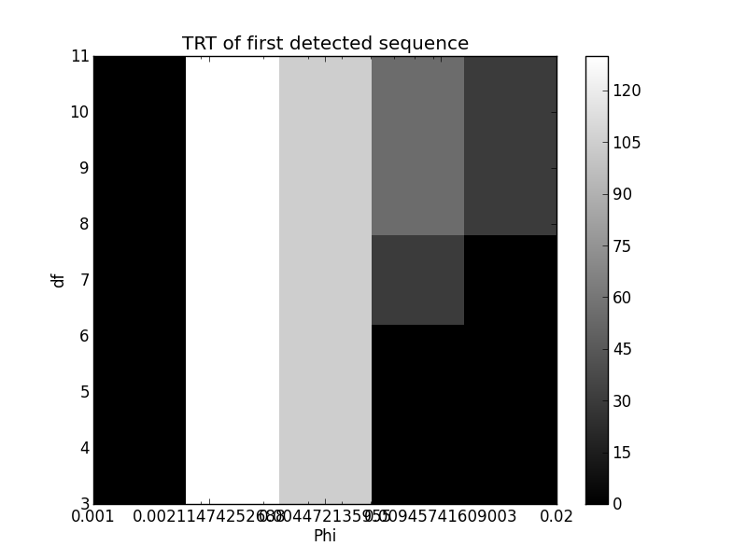
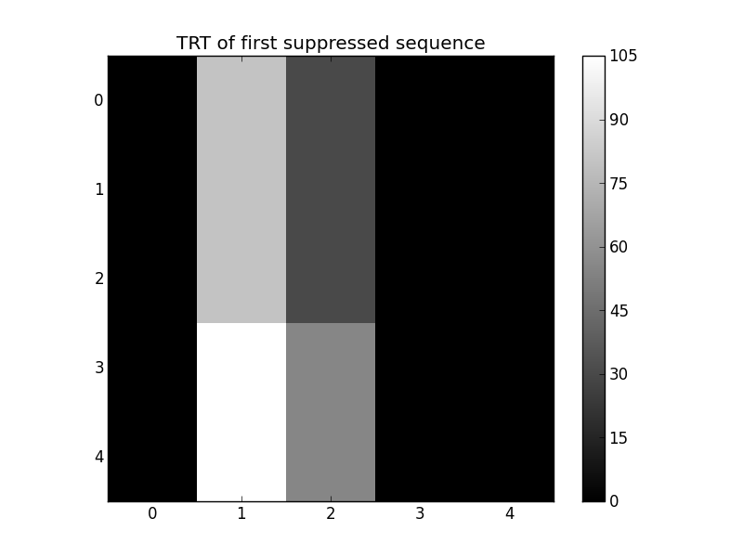
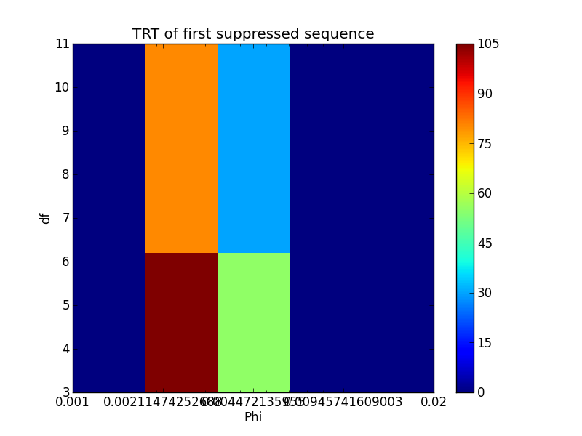
Parameter search

Slide 83
Analytical solution
++

